Slide 1
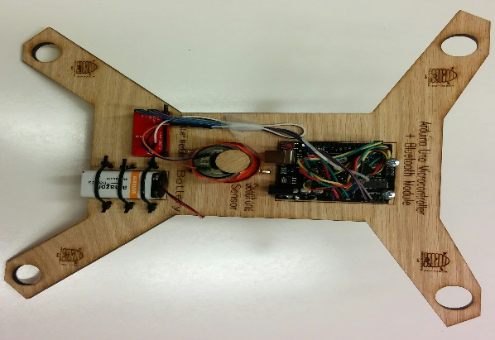
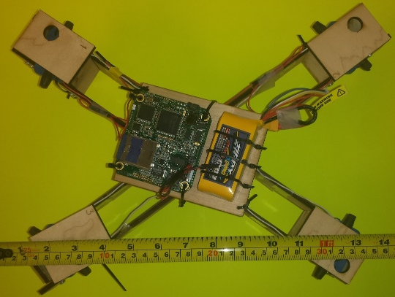
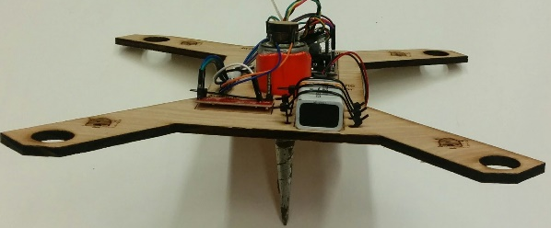
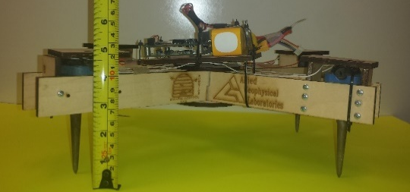
a.
Amplifier
Micro-controller
b.
Seismic recorder (micro-controller)
Battery
Battery
Geophone Sensors
with spikes
Geophone Sensors
with spikes

